Slide 1

Performance Improvement Highlights in D6.5

Slide 2


D6.5 Performance Improvement Areas
Significant performance improvements have been developed in
D6.5 compared to D5.3 in the following areas:
  Webtop Response Time
  CPU Resource Footprint
  Web Server Scalability
  Content Transfer
  High Volume Server
  XML Store

Slide 3
D6.5 Performance Improvements Summary
Webtop response times are faster
UCF transfer times are faster
Improved user capacity & cost of ownership for application servers
Reduction in CPU load with Content Server, App Servers, & Databases
High speed ingestion can handle the most demanding transaction loads
Ultra high speed ingestion is now possible to quickly load, delete, swap, and manage billions of objects
The new XML Store allows for fast XML content ingestion and retrieval

Slide 4
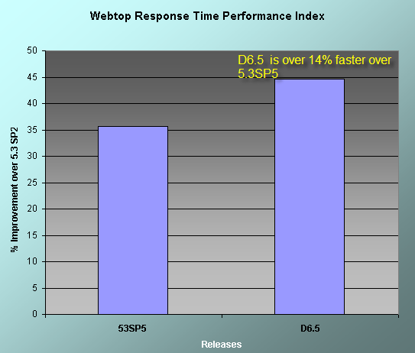
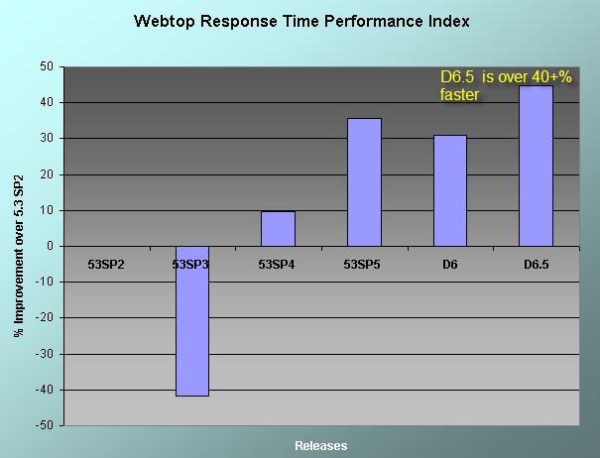
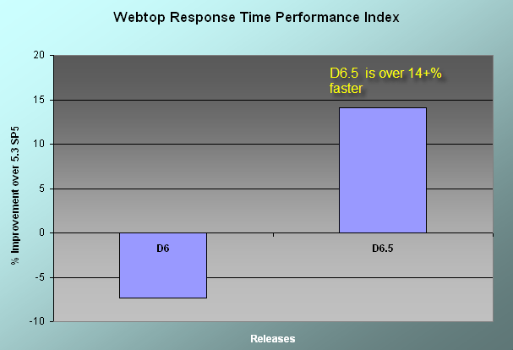
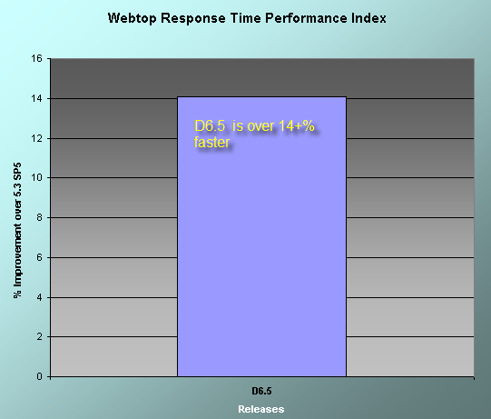
Webtop Response Time is Faster
For common Webtop transactions, response times have decreased
by over 14% compared to D5.3
faster
slower

Slide 5
Quicker Webtop UI
The New Inline Request Infrastructure has these benefits:
Enables partial page refresh
  Significant improvements in task oriented response time
Improved usability
  More like an application, less like a web site
Avoids re-rendering entire pages
  State changes can be rendered in-line
Conserves bandwidth
  Transfer only data, and only when needed by the client
Reduces server load
  Construct data only when the client needs it
Quicker user interactions
  Maintains acceptable response times

Slide 6
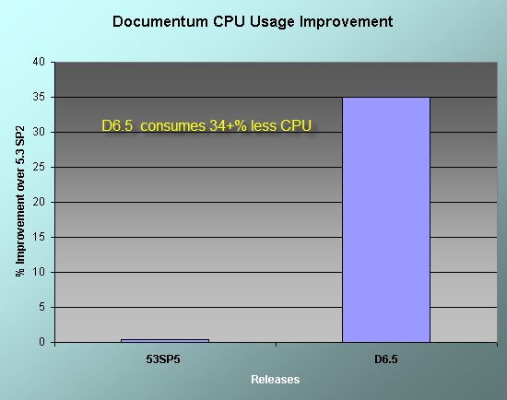
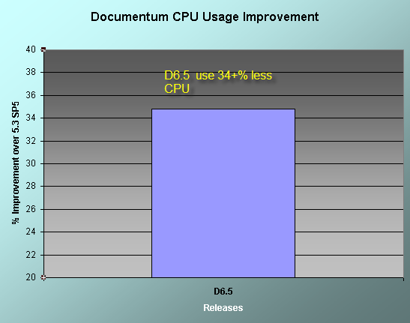
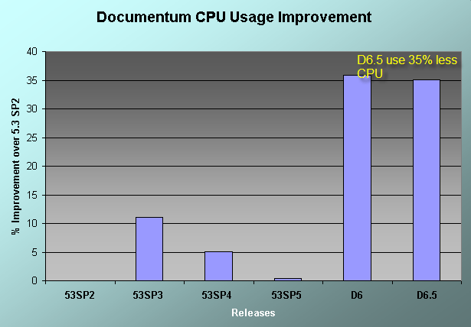
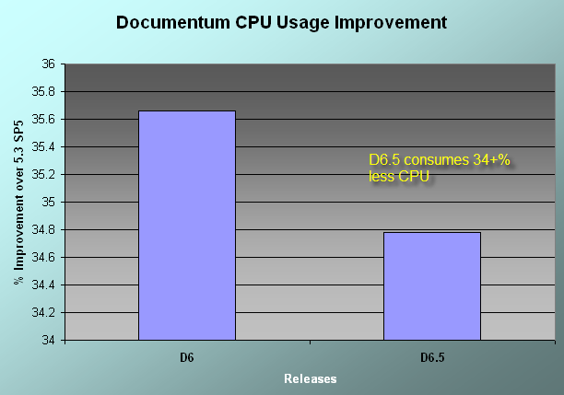
Reduction in CPU Resource Footprint
CPU usage for Content Server, App Server, and DB now use 34%
less CPU compared to D5.3
better
worse
CPU cost is calculated by adding up the Web Server, Content Server and Database Server for the same amount of workload

Slide 7
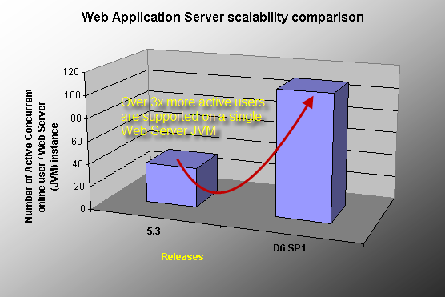
Scalability For More Users Per App Server
Over 3 times more users can be supported on one instance of an
application server compared to D5.3
Notes:
EMC CMA has updated customer that our recent D6 SP1 Benchmark done at HP lab is showing a current user support ratio up to 100-150 per JVM. (this is about 3 times higher than the previous 37.5 user / JVM E&Y load test)

Slide 8


More Users Per App Server = Less Total Cost of Ownership
D5.3
Users per JVM
D6.5
3x Users per JVM
JVM
JVM
Notes:
EMC CMA has updated customer that our recent D6 SP1 Benchmark done at HP lab is showing a current user support ratio up to 100-150 per JVM. (this is about 3 times higher than the previous 37.5 user / JVM E&Y load test)

Slide 9
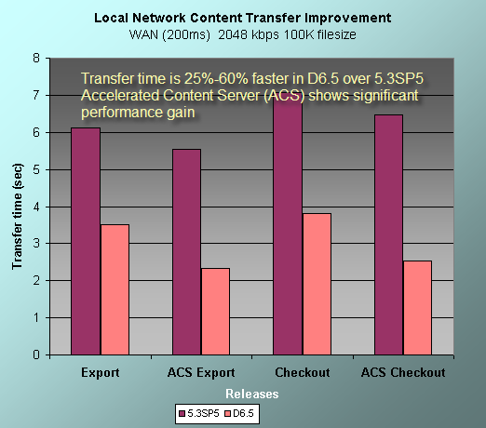
UCF Content Transfer Response Time Improvements
UCF content transfer time is 25% - 60+% faster with D6.5 compared to 5.3
5.3
worse
5.3
5.3
5.3
6.5
better
6.5
6.5
6.5

Slide 10
High Volume Server Optimized for Billions of Objects
As the number of images or documents grows (millions, billions)….
…the system cost is as constant as possible
Cost defined by:
  Number of required servers
  Disk Space & I/O cost
  Operational maintenance cost
D6.5 Provides VLDB support
  Light Weight objects
  Data Partitioning and enables high speed bulk ingestion
Image, record, & document load
System cost
Time

Slide 11
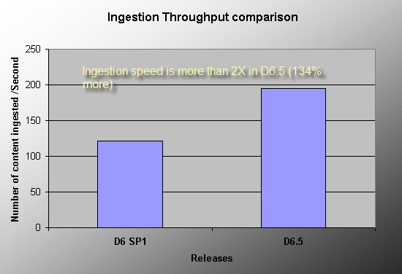
High Speed Ingestion with High Volume Server
The newly introduced 6.5 High Volume Server is able to ingest
content at least 2 times faster than D6:
faster
slower
Notes:
Title
Month Year

Slide 12
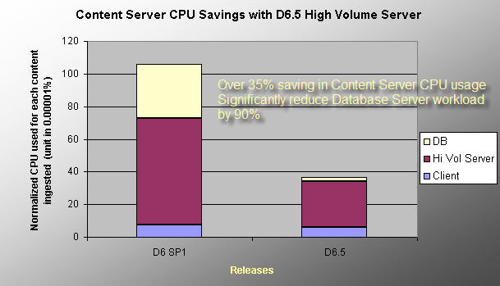
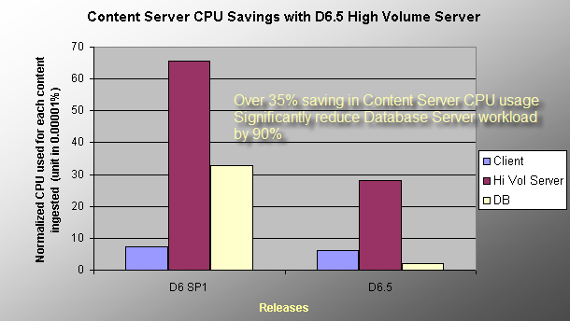
Reduced Resource Consumption with High Volume Server
The newly introduced 6.5 High Volume Server produces CPU
resource savings of over 90 % for DB server, 35% for Content Server
worse
better
Notes:
Title
Month Year

Slide 13
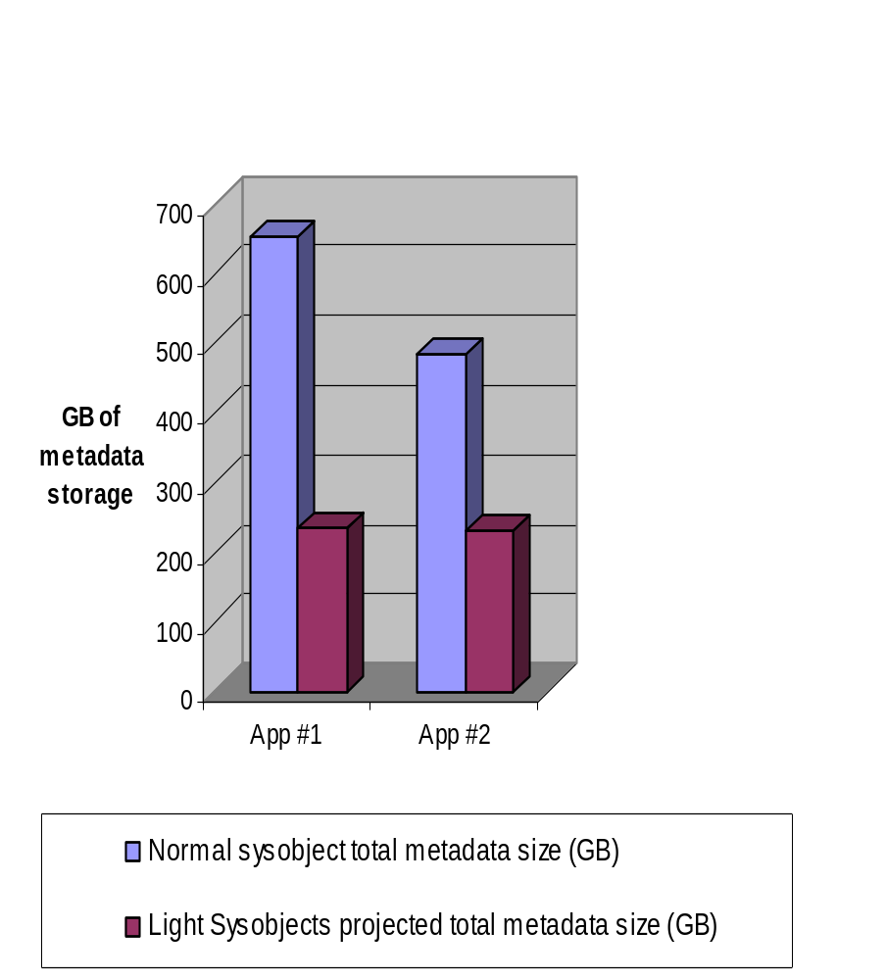

Dramatic Space Savings with Light Weight Sysobjects
Although savings will vary by application, most studied applications are projected to cut the metadata size to 25 to 50% of its original size
In typical production environments this savings is magnified by the corresponding amount saved in storage for online database backups
Examples so far include:
  Email archiving
  Check image processing
  Shipment tracking
$$$
$

Slide 14
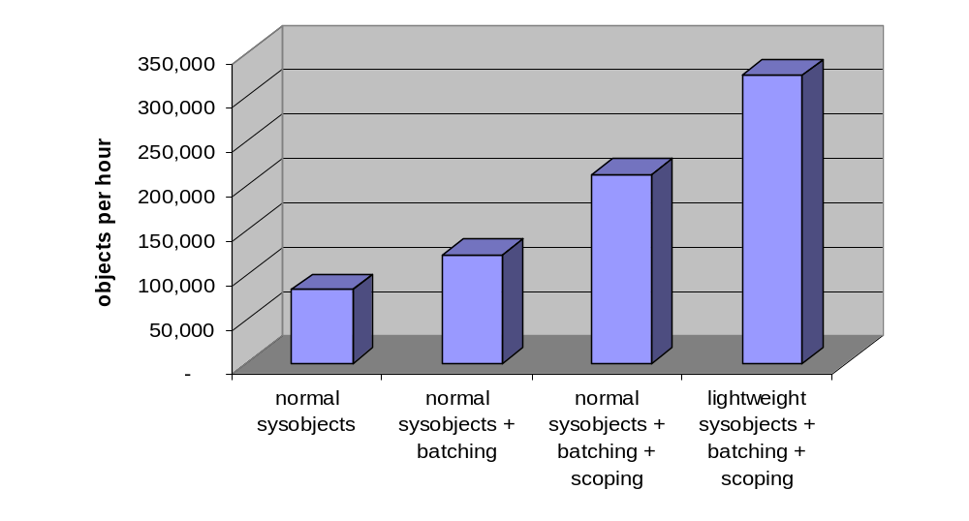
High Speed Single Stream Ingestion
Batching and Scoping improves single stream ingestion
performance
better
worse
Light-weight sysobjects combined with batching and scoping provide a significant boost with ingestion performance
Performance improvement will vary. The ingest of ‘objects’ depends partially on the size of the content being ingested
  The larger the content the less the gain

Slide 15
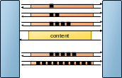

Increased Performance with DFC Scoping
Scoping decreases RPC message overhead & improves batch
ingest speed
slower
Improvement time to load multiple objects
faster
No Scoping
Scoping

Slide 16
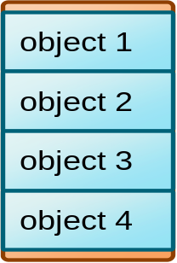
Increased Performance with DFC Batching
Batching improves DFC performance by reducing code
transactions
Batching reduces message traffic
object 1
object 2
object 3
object 4
Batching goes a step further to batch up message traffic for multiple object creations in even fewer messages
Operations for several objects can be processed in a single message stream between client Content Server and the database

Slide 17
Ultra-High Speed Ingestion With Range Partitioning
Range Partitioning enables ultra-high speed ingestion of billions
of objects
Ingestion Method
Objects Per Hour
Single threaded ingestion (D6.5 transactional)
324,000
D6.5 Partitioned based ingestion single object stream
20,000,000
The above results are from internal tests of D6.5
In the partitioned-based ingestion 100,000,000 objects loaded in less than 5 hours
Lightweight objects modeled a check imaging application with content stored in a Documentum external store

Slide 18
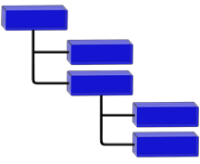
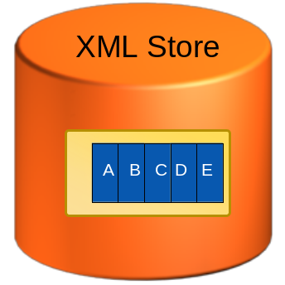



New XML Store
The new XML Store allows for fast ingestion and retrieval of XML
content
A
B
C
D
E
The New XML Store allows all elements and attributes to be queried and returned without the need of chunking
  Nodes stored to page
  Accessible via XQuery
Chunking can now be minimally relegated to reuse and security

Slide 19
D6.5 Performance Improvements Summary
Webtop response times are faster
UCF transfer times are faster
Improved user capacity & cost of ownership for application servers
Reduction in CPU load with Content Server, App Servers, & Databases
High speed ingestion can handle the most demanding transaction loads
Ultra high speed ingestion is now possible to quickly load, delete, swap, and manage billions of objects
The new XML Store allows for fast XML content ingestion and retrieval
This presentation and more whitepapers of D6.5 topics can be
retrieved online on Powerlink under the Documentum Whitepapers
section.

